Slide 1
Using Social Media
sdstate.edu/socialmedia
sdsu.socialmedia@sdstate.edu

Slide 2
About SDSU’s Social Media
University-wide social media accounts
Facebook
Twitter
Instagram
Snapchat
LinkedIn
Flickr
YouTube
Social media resources, guidelines, cover photos and avatars
Account directory

Slide 3
Overall Goals
Promote SDSU accomplishments
Increase interaction and engagement with SDSU
Lead university-wide social media campaigns
Support social media efforts across campus
Notes:
Are you signed up for our newsletter? Email sdsu.socialmedia@sdstate.edu if you’d like to receive updates and resources on social media.

Slide 4
Social Media Content
Think about your audiences and goals
Determine the best platforms
Research and post engaging content
Create new content
Re-share content
Monitor content and discussions
Analyze content and its effectiveness
Make changes for future posts

Slide 5
How to determine your goals
Think about your ideal audience:
Prospective and current students
Alumni
Fans and stakeholders
Recruitment vs. awareness
Quality of engagement vs. quantity of followers

Slide 6
Social Media Platforms
Social media platform | Percentage of 2014 high school seniors | Percentage of higher education institutions
Facebook | 75% | 99%
YouTube | 73% | 82%
Instagram | 49% | 53%
Twitter | 38% | 90%
Snapchat | 37% | 3%
Notes:
These statistics are based on a 2014 report from higher education consulting firm Noel Levitz.
Link: https://www.ruffalonl.com/papers-research-higher-education-fundraising/recruitment-marketing-and-financial-aid/e-expectations-research-reports
On this page, higher education institutions are specifically other four-year public colleges and universities.

Slide 7
Engaging Content
Photos, videos, text and links
Informational content vs. emotional content
What makes content engaging?
Depends on your audience
Share a variety of different types of posts
Algorithms

Slide 8
Engaging Students
Recruit prospective students by showing what current students do
Allow tagging on your posts to increase sharing and engagement
Utilize call to action features
Facebook: Add buttons to your Facebook page that allow users to contact you or go to the website
Twitter: Use the new Twitter Card feature
Notes:
Other ways to engage students include capitalizing on university-wide events, especially sporting events, as well as big university news features. Your college or department represents SDSU and an industry so sharing that kind of content on a regular basis will grow your audience over time.

Slide 9
Hashtags
University Hashtags:
#sdstate
#gojacks
#jackrabbitsforever
#ilovesdstate (starts September 28)
#sdstateabroad
Notes:
#sdstate is our main, university-wide hashtag.
#gojacks is a general hashtag used mainly for Athletics-related content
#jackrabbitsforever is the Alumni Association main hashtag. They also use #FutureJackrabbit (for children of alumni) and in May they feature posts with #50yearclub to celebrate the alumni group’s 50-year reunion.
#ilovesdstate is a hashtag to promote what students and alumni love about South Dakota State led by the Alumni Association. This year’s event is the week of September 28. Check out their Facebook page for more information.
#sdstateabroad is to showcase the study abroad experiences of SDSU students.

Slide 10
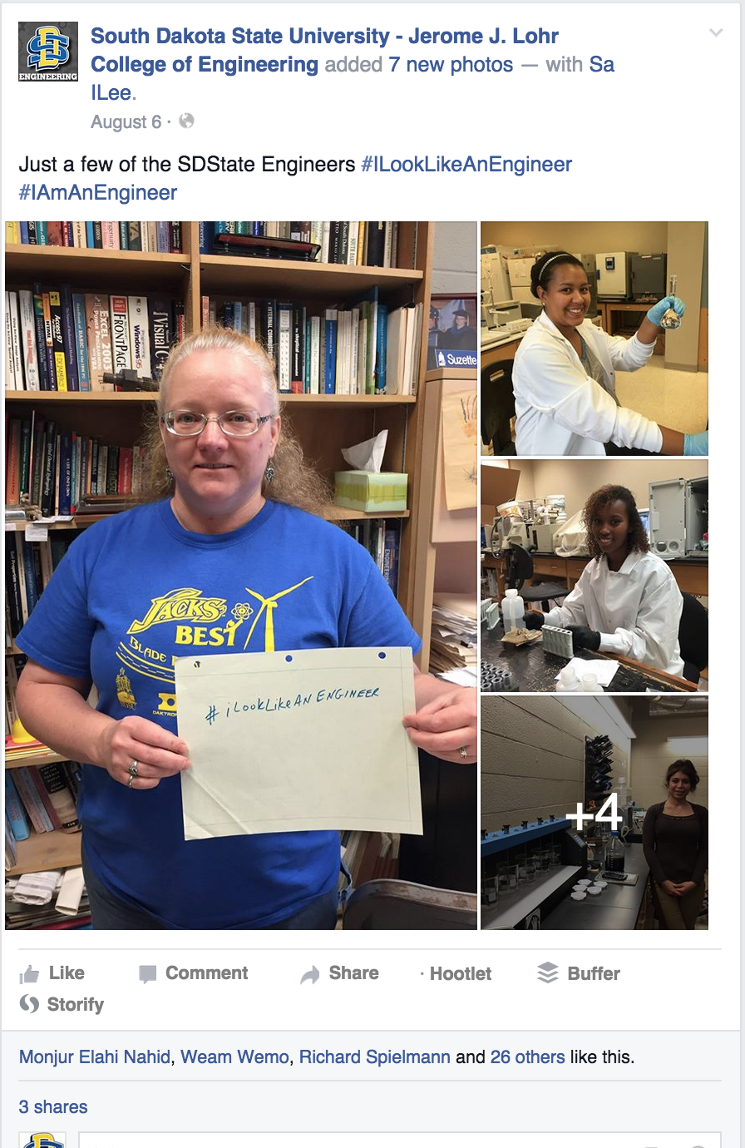
#ILookLikeAnEngineer

Slide 11
Hashtag Campaigns
Annual, university-wide campaigns
Summer
Welcome Back | #newjacks15
Fall
Homecoming | #hoboday
Spring
Graduation | #sdstate15
Notes:
Welcome Back: A campaign for orientation and move-in day that kicks off in the summer during new student orientation and ends by welcoming new and returning students to campus for move-in day at the end of August. For this campaign, we create several videos explaining the move-in day experience as well as a series of videos starring Jack as he gets ready to welcome students back to campus.
Hashtag: #newjacks15 (changes based on the year of the campaign)
Website: http://newjacks.sdstate.edu
Homecoming: To celebrate #hoboday, we collaborate with Yeager Media Center, the Hobo Day Committee, Classroom Technology Services, and State Tech to live stream the Hobo Day Parade. This campaign also includes posts promoting the Hobo Day Committee activities and other SDSU-related Hobo Day events.
Hashtag: #hoboday
Website: http://sdstate.edu/hoboday
Graduation: The culminating event of every student’s academic career is graduation day. To showcase our students’ achievements, we create posts counting down to graduation, share a preview video and re-share photos of students getting ready for graduation. We also collaborate with Daktronics and Classroom Technology Services to live stream both commencement ceremonies each year and post a photo album on the day of graduation as well as a recap video of the day’s events.
Hashtag: #sdstate15 (changes based on the year of the campaign)
Website: http://sdstate.edu/graduation

Slide 12
Monitor Conversations
Respond to questions and comments quickly whether they are positive or negative
Create saved searches on Twitter and get alerts with a hashtag or mention

Slide 13
Analyzing Content
It’s different for each network:
Reach
Engagement vs. Engagement Rate
Impressions
Views

Slide 14
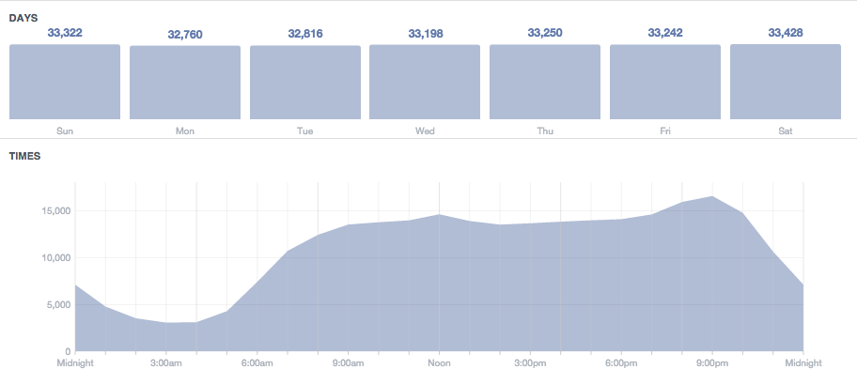
Analyzing Content
Peak times and peak engagement
Notes:
On Facebook, go to Insights > Posts. It does not keep track of your data from week to week, so I recommend keeping screenshots of each week’s data and comparing it to see a good pattern of when your best posting times are.
For Twitter, go to http://www.tweriod.com/ and sign in with your Twitter account. You can view your optimized times based on the day of the week.
For Instagram, go to http://iconosquare.com/ and sign in with your Instagram account. Then click the “Optimization” option on the left menu.

Slide 15
Social Media Content
Think about your audiences and goals
Determine the best platforms
Research content
Share content
Create new content
Post engaging content
Monitor content and discussions
Analyze content and its effectiveness
Make changes for future posts

Slide 16
Questions?
sdstate.edu/socialmedia
sdsu.socialmedia@sdstate.edu

