Slide 1


New Data Products Available at the LP DAAC
Kari Beckendorf, LP DAAC Scientist
Innovate, contractor to the USGS EROS Data Center, work performed under USGS contract G10PC00044

Slide 2

Overview
Overview of the LP DAAC and NASA MEaSUREs
New MEaSUREs Data Products at the LP DAAC
Examples of Data Uses
Access MEaSUREs Products
MEaSUREs Products coming to the LP DAAC

Slide 3
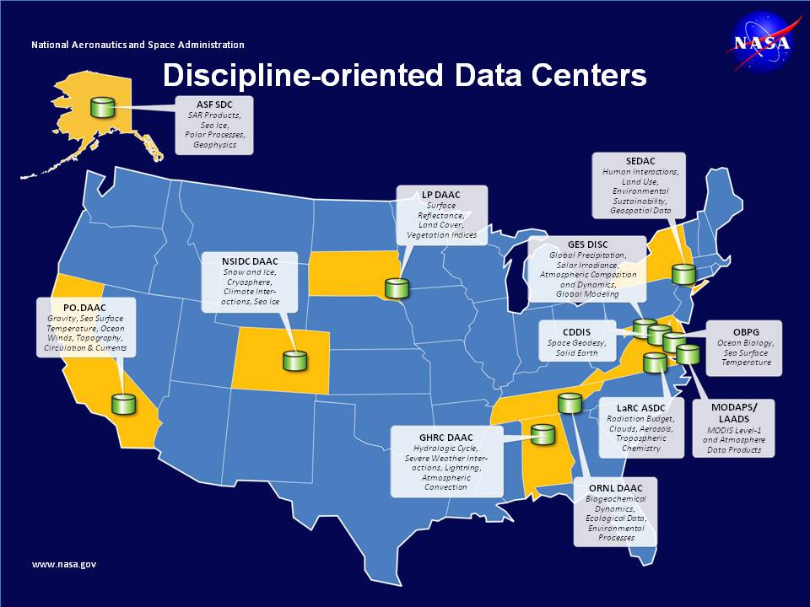
Land Processes Distributed Active Archive Center (LP DAAC)

Slide 4
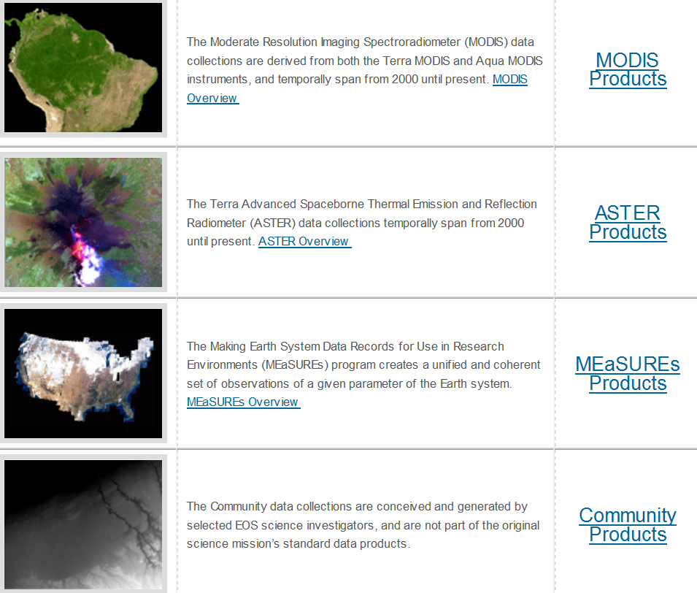
LP DAAC Data Products, https://lpdaac.usgs.gov/products

Slide 5

NASA MEaSUREs
What is NASA MEaSUREs?
  Making Earth Science Data Records for Use in Research Environments (MEaSUREs)
  Support by NASA’s Earth Science Program
  Past solicitations 2006 and 2012
How is the LP DAAC involved with NASA MEaSUREs?

Slide 6

New MEaSUREs Data Products
NASA SRTM Version 3.0 (SRTM Plus)
  Shuttle Radar Topography Mission (SRTM)
  Created by the Jet Propulsion Laboratory (JPL)
  Principal Investigator: Michael Kobrick, JPL
  https://lpdaac.usgs.gov/products/measures_products_table

Slide 7

New MEaSUREs Data Products
WELD Version 1.5
  Web-Enabled Landsat Data (WELD)
  Created by South Dakota State University (SDSU)
  Principle Investigator: David Roy, SDSU
  https://lpdaac.usgs.gov/products/measures_products_table

Slide 8

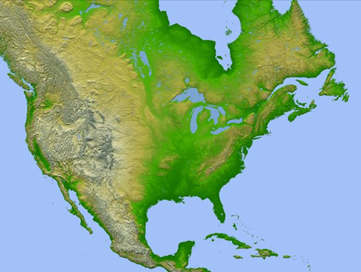
Shuttle Radar Topography Mission (SRTM) Overview
Collaborative Mission
Generate near-global digital elevation models (DEMs) of Earth
Collected February 2000
Acquired DEM of all land between 60º north latitude and 56º south latitude

Slide 9
SRTM Genealogy
Unfinished / Version 1.0
JPL/NASA
NGA
Version 2.0
Finished
Version 2.1
Void Filled
Version 3.0

Slide 10
NASA SRTM Versions and Characteristics
1.0
NASA JPL processed to transform radar echoes into stripes of DEMs, and mosaicked into 14,278 1ºx1º tiles (Farr, 2000).
2.0
Applied post-processing steps from the National Geospatial Intelligence Agency (NGA) to edit, remove spikes and pits, level water bodies and define coastlines.
2.1
3.0
Minor error corrections in Version 2.0, 3 arc-second products. Recalculated the 3 arc-second products by 3x3 averaging of the edited data.
SRTM Version 3.0 eliminated voids in the SRTM data by filling with ASTER GDEM2, USGS GMTED2010, or USGS NED elevation models.

Slide 11
NASA SRTM Version 3.0, Data used to fill voids
Data Product | Spatial Resolution | Coverage | Created By
ASTER Global Digital Elevation Model, Version 2.0 (GDEM2) | 1 arc-second | North 83º to South 83º, 22,702 tiles | NASA / Japan’s Ministry of Economy, Trade, and Industry (METI).
Global Multi-resolution Terrain Elevation Data 2010 (GMTED2010) | 7.5 arc-second, converted to 1 arc-second | Global | USGS / NGA
National Elevation Dataset (NED) | 1-arc second | United States, Alaska, Hawaii, Puerto Rico, U.S. territorial islands, Mexico and Canada | USGS

Slide 12
NASA SRTM Version 3.0, Data Products
Data Product | Short Name | Spatial Resolution | Coverage | Format
SRTM Global 3 arc-second | SRTMGL3 | 3 arc-second | 60º north--56º south latitude | Height (.HGT)
SRTM Global 3 arc-second number | SRTMGL3N | 3 arc-second |  | Number (.NUM)
SRTM Global 3 arc-second sub-sampled | SRTMGL3S | 3 arc-second |  | (.HGT)
SRTM Water Body Data | SRTMWBD | 1 arc-second |  | Shapefile/Raster
SRTM US 1 arc-second | SRTMUS1 | 1 arc-second | U.S. and | (.HGT)
SRTM US 1 arc-second number | SRTMUS1n | 1 arc-second | Territories | (.NUM)

Slide 13
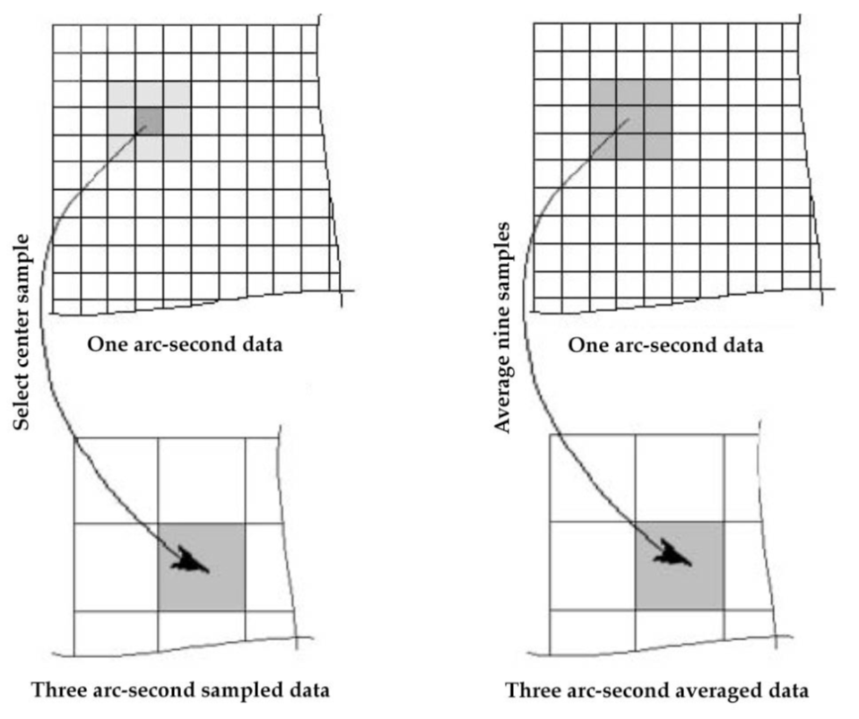
NASA SRTM Version 3.0, Sampling Methods
Global 3 arc-second sub-sampled
Global 3 arc-second

Slide 14
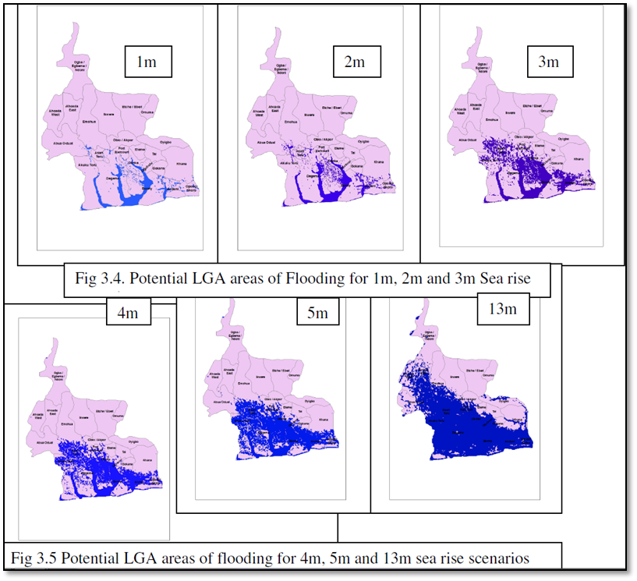
SRTM Data Use Examples, Predicting Floods
Sea Level Rise Scenarios (meters) | Affected Local Government Areas
1 | 10
2 | 12
3 | 12
4 | 13
5 | 13
13 | 22
Onwuteaka, John, 2014, GIS Modeling of Flooding Exposure in Nigerian Coastal Areas from Sea Level Rise: Journal of Environment and Earth Science, v. 4, no. 12, p. 81-94.

Slide 15
SRTM Data Use Examples, Measure Mangrove Height and Biomass
Simard, Marc and others, 2006, Mapping Height and Biomass of Mangrove Forests in Everglades National Park with SRTM Elevation Data: PE&RS v. 72, no.3, p. 299-311.

Slide 16
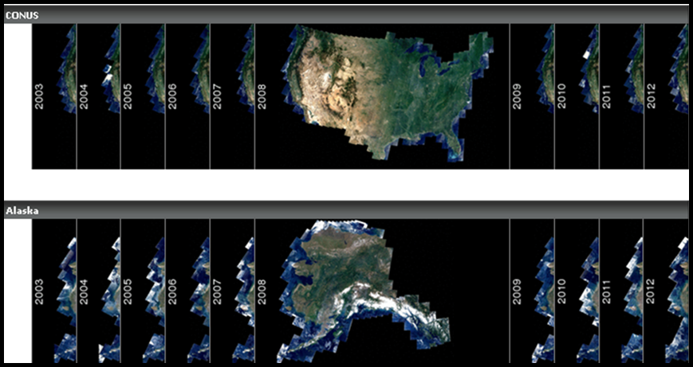
Web-Enabled Landsat Data (WELD) Overview
Generate “seamless” consistent mosaicked Landsat Enhanced Thematic Mapper Plus (ETM+)
Landsat ETM+ Level 1 Terrain (L1T) acquisitions
Cover the Continental U.S. (CONUS) and Alaska from 2003—2012
Are pre-processed and ready to use
Notes:
LT1 (Level 1 terrain corrected (L1T)

Slide 17
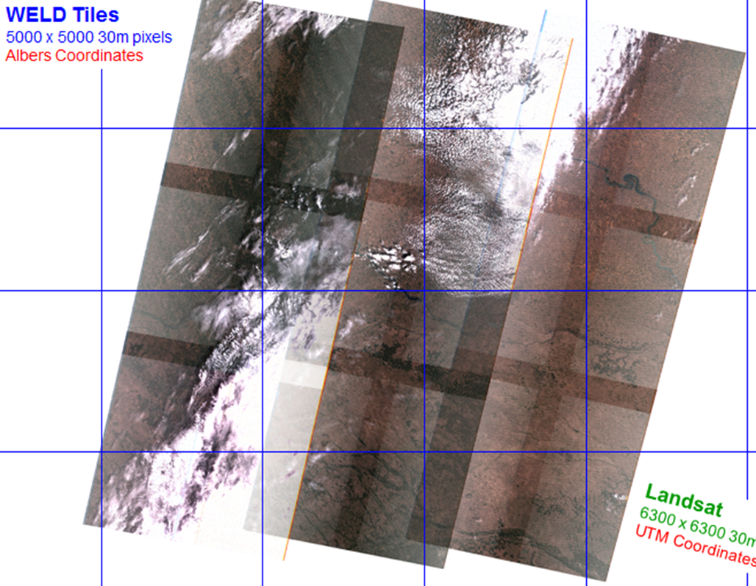
WELD, Input Data Landsat ETM+ L1T

Slide 18


WELD, Processing
Digital Numbers
scene-specific sensor gain and bias coefficients
Spectral Radiance
Reflective
Thermal
Normalized Difference Vegetation Index
NIR-RED /
NIR + RED
Top-of –Atmosphere Reflectance (unitless)
Brightness Temperature
(K)

Slide 19
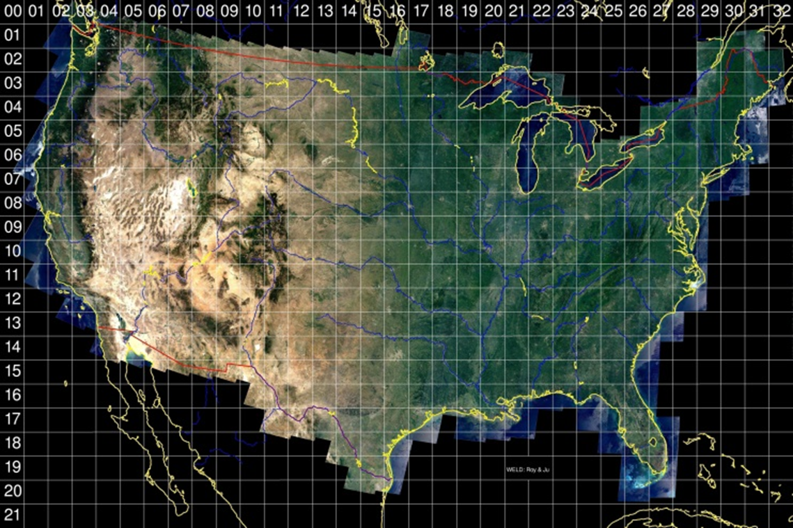
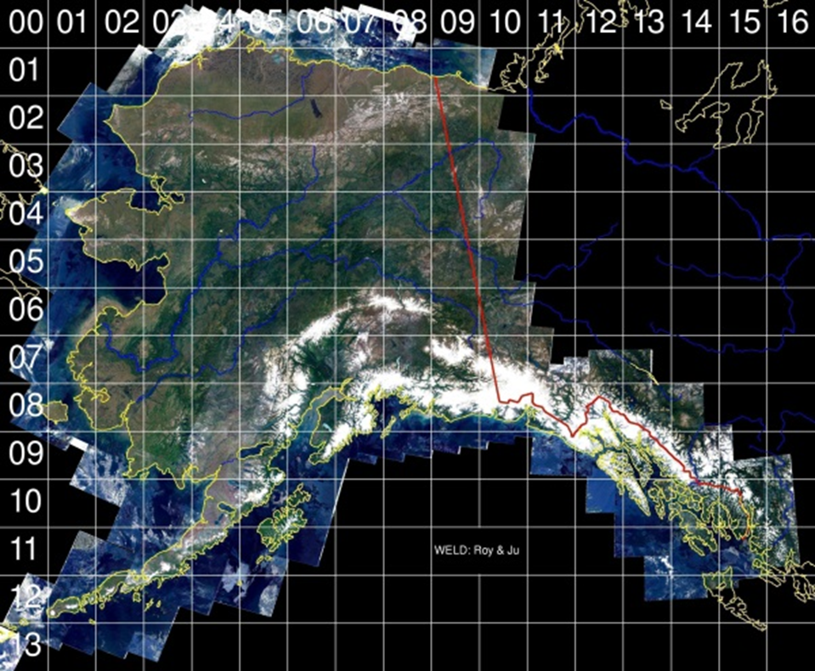
WELD, Reprojected and Tiled
Reprojected to Albers Equal Area Projection
Resampled
Tiled

Slide 20
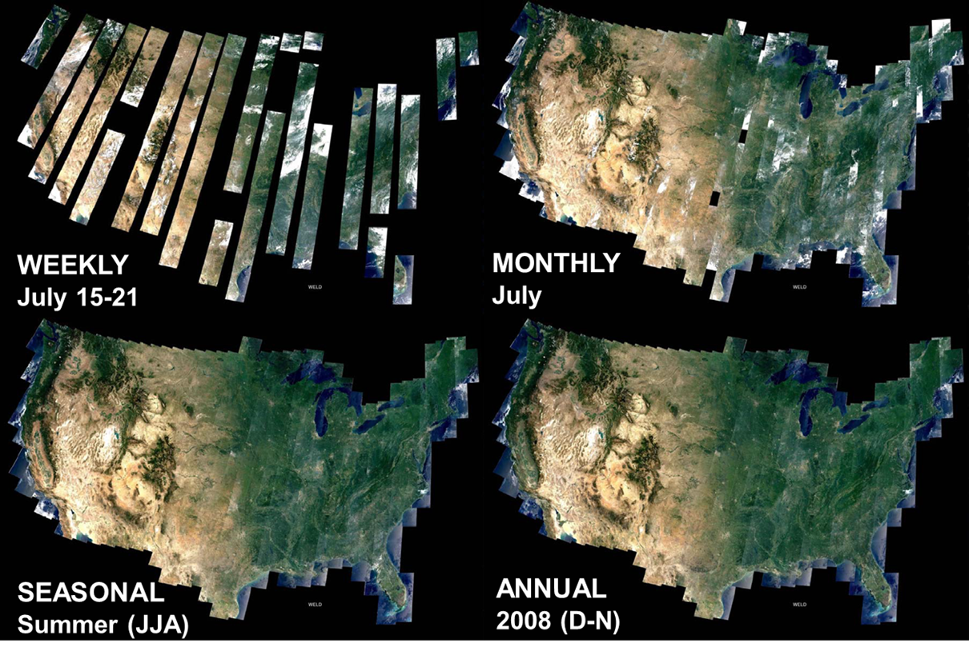
WELD Versions 1.5 Data Products

Slide 21
WELD Version 1.5 Data Products
Data Product | Short Name | Spatial Resolution | Coverage | Format
WELD CONUS Lat/Long | WELDUSLL | 30 meters | CONUS | HDF
WELD CONUS Monthly | WELDUSMO | 30 meters | CONUS | HDF
WELD CONUS Seasonal | WELDUSSE | 30 meters | CONUS | HDF
WELD CONUS Weekly | WELDUSWK | 30 meters | CONUS | HDF
WELD CONUS Annual | WELDUSYR | 30 meters | CONUS | HDF
WELD Alaska Lat/Long | WELDAKLL | 30 meters | Alaska | HDF
WELD Alaska Monthly | WELDAKMO | 30 meters | Alaska | HDF
WELD Alaska Seasonal | WELDAKSE | 30 meters | Alaska | HDF
WELD Alaska Weekly | WELDAKWK | 30 meters | Alaska | HDF
WELD Alaska Annual | WELDAKYR | 30 meters | Alaska | HDF

Slide 22
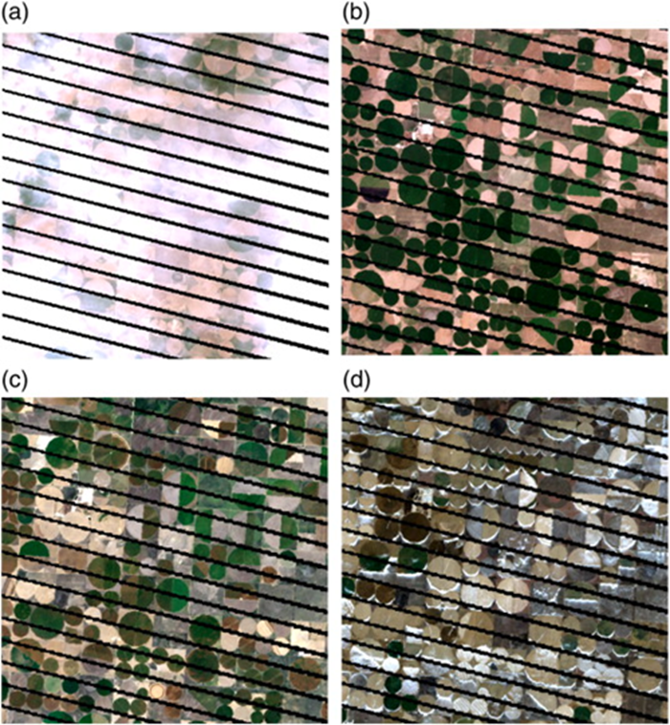
WELD Data Use Example, Agriculture
Yan, Lin and Roy, David, P., 2014, Automated crop field extraction from multi-temporal Web Enabled Landsat Data: Remote Sensing of the Environment v.144, p. 42-64.

Slide 23
WELD Data Use Example, Mapping Permafrost
Pastick, Neal, J. and others, 2014, Spatial variability and landscape controls of near-surface permafrost with the Alaskan Yukon River Basin: J. Geophys. Res. Biogeosci., v. 119, p. 1244-1265.

Slide 24
Accessing LP DAAC MEaSURES Products
NASA Reverb
USGS EarthExplorer
LP DAAC Data Pool
GDEx
WELD WYSIWYG (what you see is what you get)

Slide 25
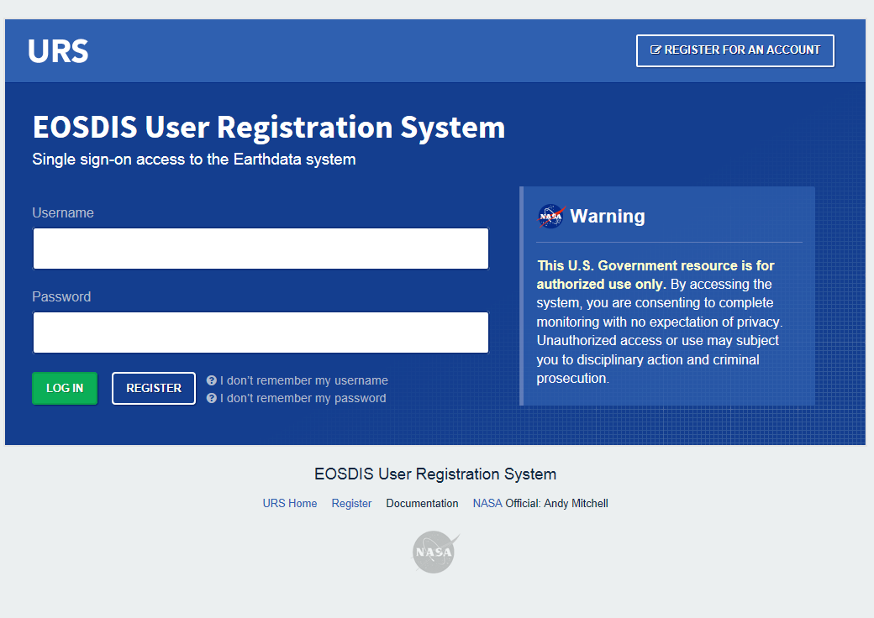
EOSDIS User Registration Systems (URS)
https://urs.eosdis.nasa.gov/
  NASA Reverb
  USGS EarthExplorer
  GDEx (SRTM Only)

Slide 26
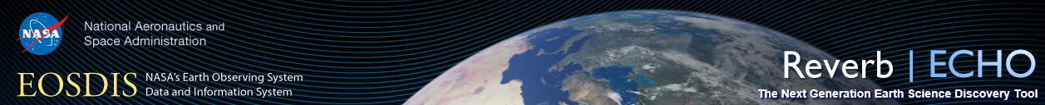
NASA Reverb
http://reverb.echo.nasa.gov/
Access Point | Type | Data | Notes
NASA Reverb | Query-based | NASA EOSDIS wide holdings | Most data sets, HDF tiles
USGS EarthExplorer | Query-based | LP DAAC & USGS EROS holdings | Many datasets, HDF tiles
LP DAAC Data Pool | Direct HTTP access | LP DAAC on-line holdings | Navigate directory structure, HDF tiles
GDEx | Spatial/Visual | ASTER GDEM & SRTM holdings | Select AOI and data format
WELD WYSIWYG* | Spatial/Visual | WELD Only | GeoTiff subsets
Notes:
*Sign In
*Spatial Search (Bounding Box, Lat/Long, Polygon, 2D coordinates (tiles), place)
*Search Terms (NASA SRTM or WELD)
*Temporal Search
*Select Datasets

Slide 27
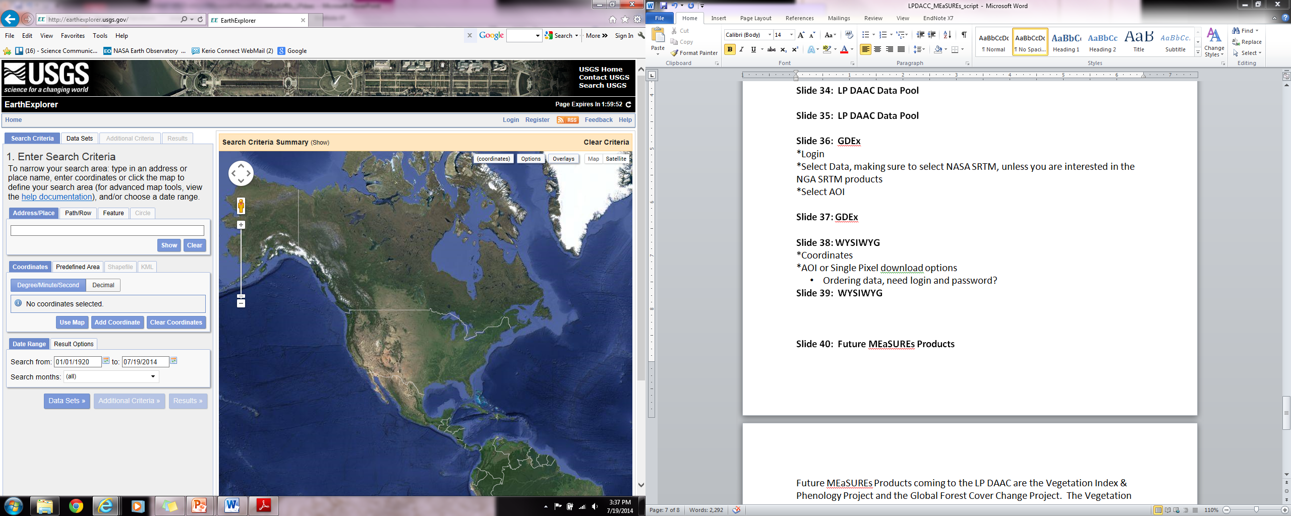
USGS EarthExplorer
http://earthexplorer.usgs.gov/
Access Point | Type | Data | Notes
NASA Reverb | Query-based | NASA EOSDIS wide holdings | Most data sets, HDF tiles
USGS EarthExplorer | Query-based | LP DAAC & USGS EROS holdings | Many datasets, HDF tiles
LP DAAC Data Pool | Direct HTTP access | LP DAAC on-line holdings | Navigate directory structure, HDF tiles
GDEx | Spatial/Visual | ASTER GDEM & SRTM holdings | Select AOI and data format
WELD WYSIWYG* | Spatial/Visual | WELD Only | GeoTiff subsets

Slide 28
LP DAAC Data Pool
https://lpdaac.usgs.gov/data_access
Access Point | Type | Data | Notes
NASA Reverb | Query-based | NASA EOSDIS wide holdings | Most data sets, HDF tiles
USGS EarthExplorer | Query-based | LP DAAC & USGS EROS holdings | Many datasets, HDF tiles
LP DAAC Data Pool | Direct HTTP access | LP DAAC on-line holdings | Navigate directory structure, HDF tiles
GDEx | Spatial/Visual | ASTER GDEM & SRTM holdings | Select AOI and data format
WELD WYSIWYG* | Spatial/Visual | WELD Only | GeoTiff subsets
Notes:
The LP DAAC Data Pool allows direct HTTP access to LP DAAC Data holdings.

Slide 29
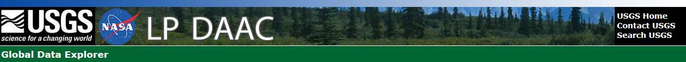
GDEx, gdex.cr.usgs.gov (SRTM Only)
Access Point | Type | Data | Notes
NASA Reverb | Query-based | NASA EOSDIS wide holdings | Most data sets, HDF tiles
USGS EarthExplorer | Query-based | LP DAAC & USGS EROS holdings | Many datasets, HDF tiles
LP DAAC Data Pool | Direct HTTP access | LP DAAC on-line holdings | Navigate directory structure, HDF tiles
GDEx | Spatial/Visual | ASTER GDEM & SRTM holdings | Select AOI and data format
WELD WYSIWYG* | Spatial/Visual | WELD Only | GeoTiff subsets
Notes:
*Login
*Select Data, making sure to select NASA SRTM, unless you are interested in the NGA SRTM products
*Select AOI

Slide 30
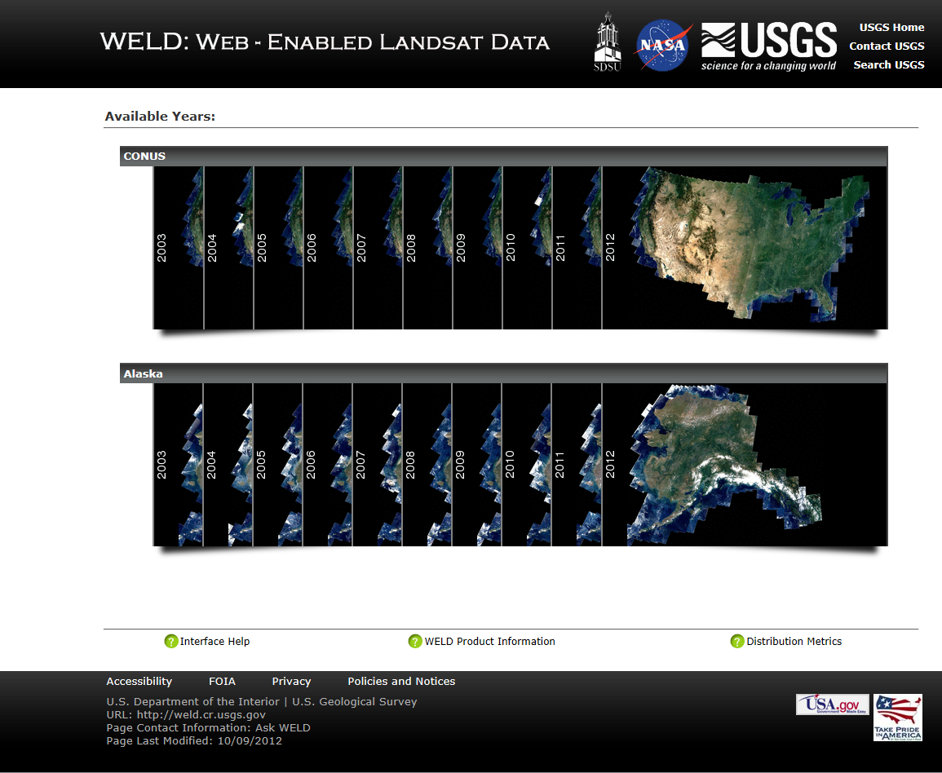
WYSIWYG, weld.cr.usgs.gov (WELD Only)
Access Point | Type | Data | Notes
NASA Reverb | Query-based | NASA EOSDIS wide holdings | Most data sets, HDF tiles
USGS EarthExplorer | Query-based | LP DAAC & USGS EROS holdings | Many datasets, HDF tiles
LP DAAC Data Pool | Direct HTTP access | LP DAAC on-line holdings | Navigate directory structure, HDF tiles
GDEx | Spatial/Visual | ASTER GDEM & SRTM holdings | Select AOI and data format
WELD WYSIWYG* | Spatial/Visual | WELD Only | GeoTiff subsets
Notes:
*Coordinates
*AOI or Single Pixel download options
Ordering data, need login and password?

Slide 31
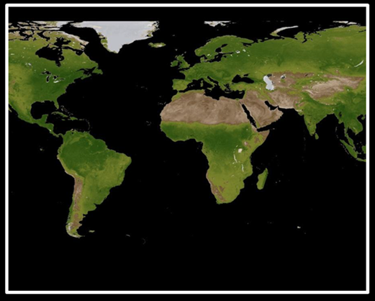
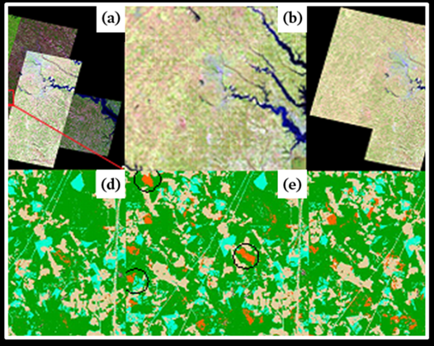
Future MEaSUREs Products
MEaSUREs 2006 Projects
  The Vegetation Index & Phenology (VIP)
  The Global Forest Cover Change (GFCC)
  The Definitive Merged Global Digital Topographic Data Set
MEaSUREs 2012 Projects
  Global Cropland Area Database (GCAD30)
  Global WELD
  Vegetation Continuous Fields
  NASADEM: Creating a New NASA Digital Elevation Model and Associated Products
Watch News Releases on the LPDAAC webpage.

Slide 32
LP DAAC MEaSUREs Support
Data Support, contact LP DAAC User Services
Voice: 605-594-6116
Toll Free: 866-573-3222 (866-LPE-DAAC)
Fax: 605-594-6963
E-mail: LPDAAC@usgs.gov
Web: https://lpdaac.usgs.gov/

